Slide 1
IT 3003 - ADVANCED PROGRAMMING TECHNIQUE
GROUP PROJECT 2020
GROUP 03

Slide 2
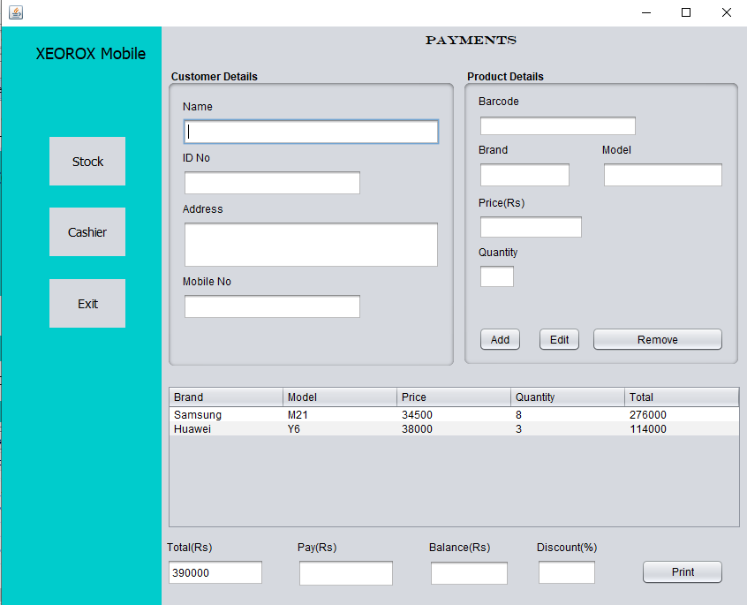
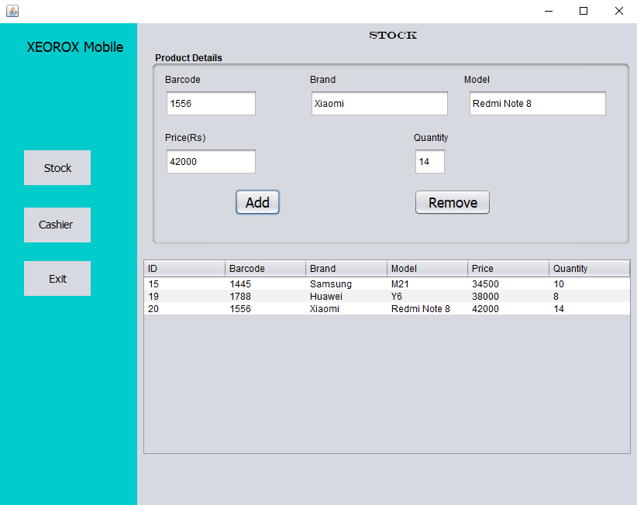
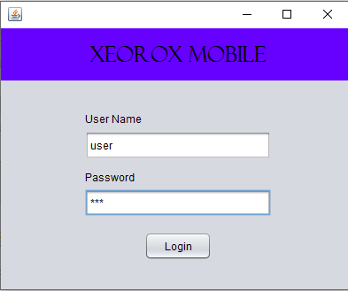

Inventory Management & Billing System

Slide 3
Group Members
Name | Index No | Corresponding Part
Guruge A.G.T.K. | S13897 | Classes & Interfaces
H.D. Supun Sameera | S13898 | UML Diagrams
Jayalath J.D.M. | S13838 | Coding Standards
Jayasekara P.W. | S13839 | GUI Elements
Jayasinghe K.D.V.C | S13993 | Introduction & Data Types
Jayasundara A.U.S | S13840 | Design Pattern/Static or Dynamic Binding
Jayasuriya J.A.C.U.S | S13841 | Exception Handling

Slide 4
Primitive Data Types
A primitive data type specifies the size and type of variable values, and it has no additional methods.
There are 8 primitive data types in Java:
byte | 1 byte | Stores whole numbers from -128 to 127
short | 2 bytes | Stores whole numbers from -32,768 to 32,767
int | 4 bytes | Stores whole numbers from -2,147,483,648 to 2,147,483,647
long | 8 bytes | Stores whole numbers from -9,223,372,036,854,775,808 to 9,223,372,036,854,775,807
float | 4 bytes | Stores fractional numbers. Sufficient for storing 6 to 7 decimal digits
double | 8 bytes | Stores fractional numbers. Sufficient for storing 15 decimal digits
boolean | 1 bit | Stores true or false values
char | 2 bytes | Stores a single character/letter or ASCII values

Slide 5
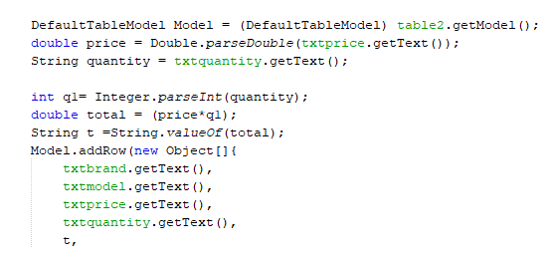
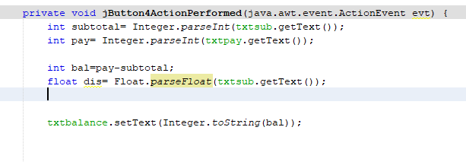
Primitive Data Types

Slide 6
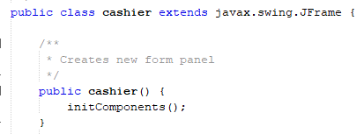
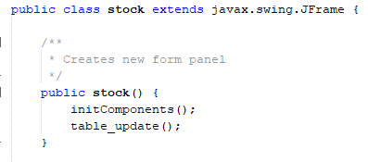
Usage of classes
Class is main aspect of object-oriented programming. To create a class, use the keyword “class”.
Java supports sub classes and super classes.
Sub classes can inherits properties and methods from their super classes.

Slide 7
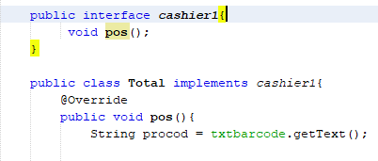
Usage of interfaces
An Interface is a completely abstract class that is used to group related methods with empty bodies. The interface cashier1 is an example for it.

Slide 8
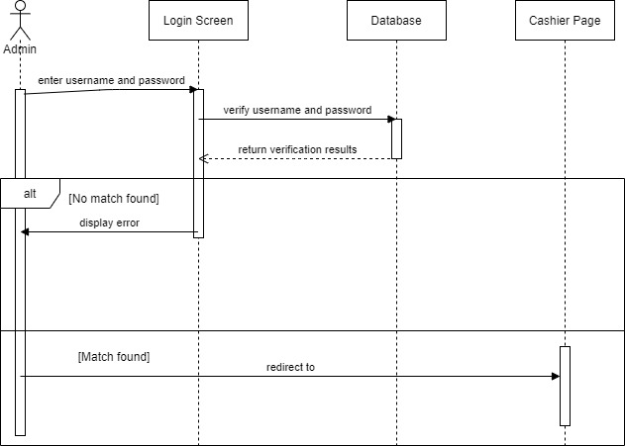
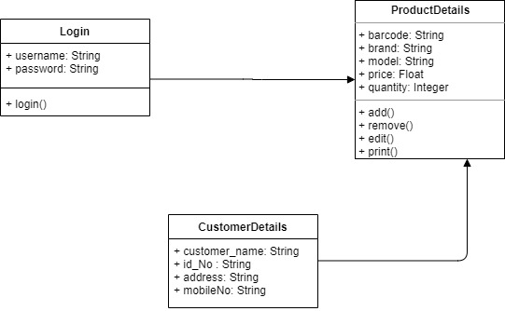
UML diagrams
Class Diagram
Sequence Diagram

Slide 9
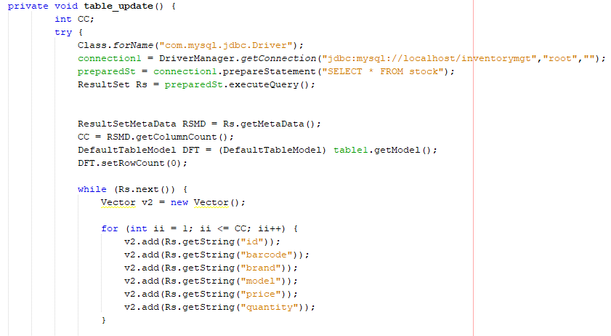
Static & Dynamic Bindings
When type of the object is determined at compiled time(by the compiler), it is known as static binding.
If there is any private, final or static method in a class, there is static binding.
Overloading example for Static Binding

Slide 10
Design patterns
Design patterns represent the best practices used by experienced object-oriented software developers. Design patterns are solutions to general problems that software developers faced during software development.
Three main categories in design patterns.
=> Creational
=> Structural
=> Behavioral
Factory Design Pattern
This type of design pattern comes under creational pattern as this pattern provides one of the best ways to create an object.
In Factory pattern, we create object without exposing the creation logic to the client and refer to newly created object using a common interface.

Slide 11
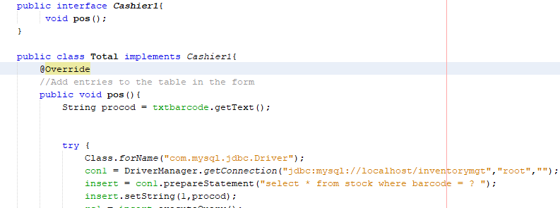
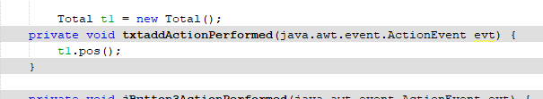
Design patterns

Slide 12
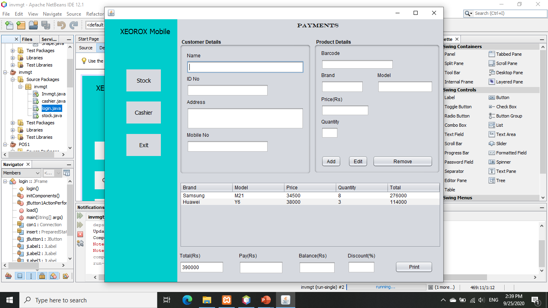
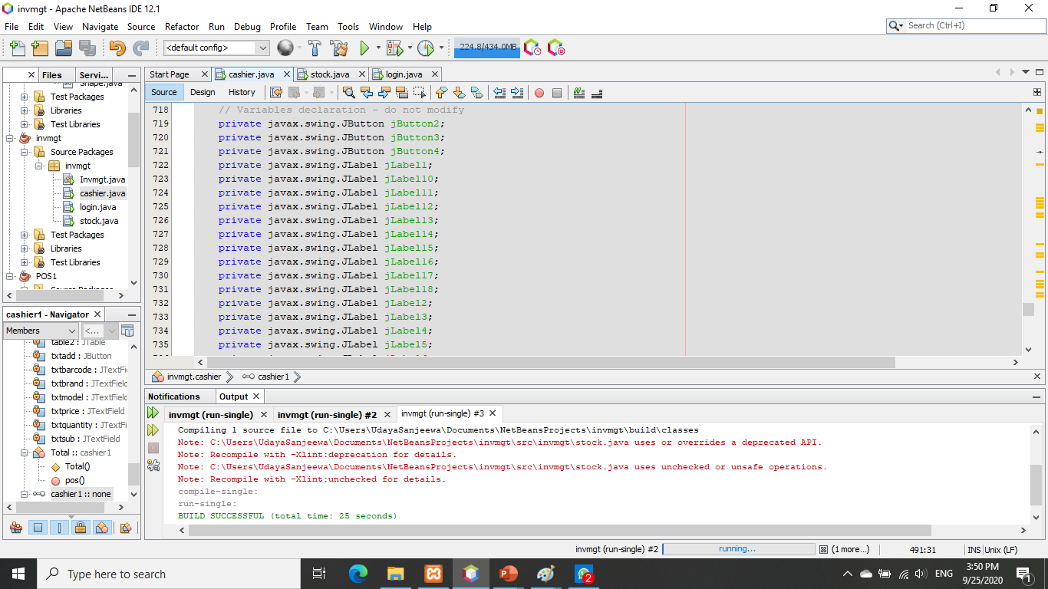
Usage of GUI Elements

Slide 13
Usage of exception handling
An exception (or exceptional event) is a problem that arises during the execution of a program
There are two types exceptions
Checked exceptions
A checked exception is an exception that is checked (notified) by the compiler at compilation-time, these are also called as compile time exceptions.
Unchecked exceptions
An unchecked exception is an exception that occurs at the time of execution. These are also called as Runtime Exceptions.
All exception classes are subtypes of the java.lang.Exception class.
Catching Exceptions
A method catches an exception using a combination of the try and catch keywords.

Slide 14
Use of proper coding standards
The purpose of having proper coding standards:
Improves code readability & maintainability
Reduces code complexity
Enables code reuse
Helps to detect errors
Increases the efficiency of the programmers

Slide 15
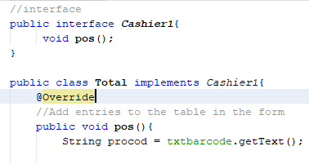
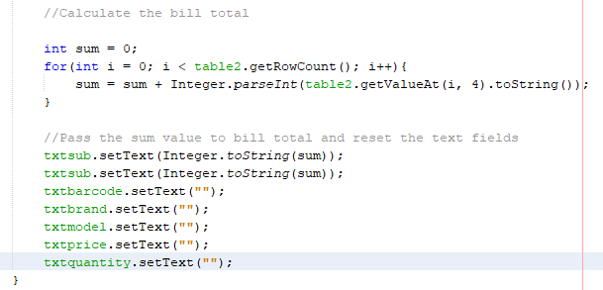
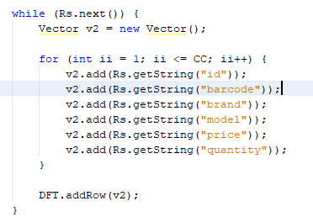
Use of proper coding standards
Example for the use of proper indentation, naming conventions and comments

Slide 16
Thank YOU

